Slide 1

React Native The Basics

Slide 2
Contents:
Introduction
What is React-Native?
Native Components and Core Components
Native Components
React Fundamentals
Components
Dev Environment Setup
Installing dependencies
Demo
Core Components
JSX
Props
State
Node, Python2, JDK
Android development environment

Slide 3
What is React-Native?

Slide 4



An open source framework and multi-platform solution created by Facebook that lets you build mobile apps using React JavaScript.
These mobile apps are considered multi-platform because they’re written once and deployed across many platforms.

Slide 5
Brief History:
React-Native was started as Facebook’s internal hackathon project in 2013.
In January 2015, react-native had its first public preview (like closed beta testing) at react.js con.
In March 2015, Facebook announce React-Native is open and available on Github. After a little year the statistics on Github repository are become very impressive: 1002 contributors committed 7,971 times in 45 branches with 124 releases, and it’s 14th most starred repository on GitHub.
In September 2016, React-Native surpassed iOS and android development according to Google trends and has become the most preferred platform for developing hybrid mobile applications.

Slide 6
















Who’s using React-Native?

Slide 7


And of course:
Fujitsu Taskforce
U-Shop

Slide 8
Native Components

Slide 9
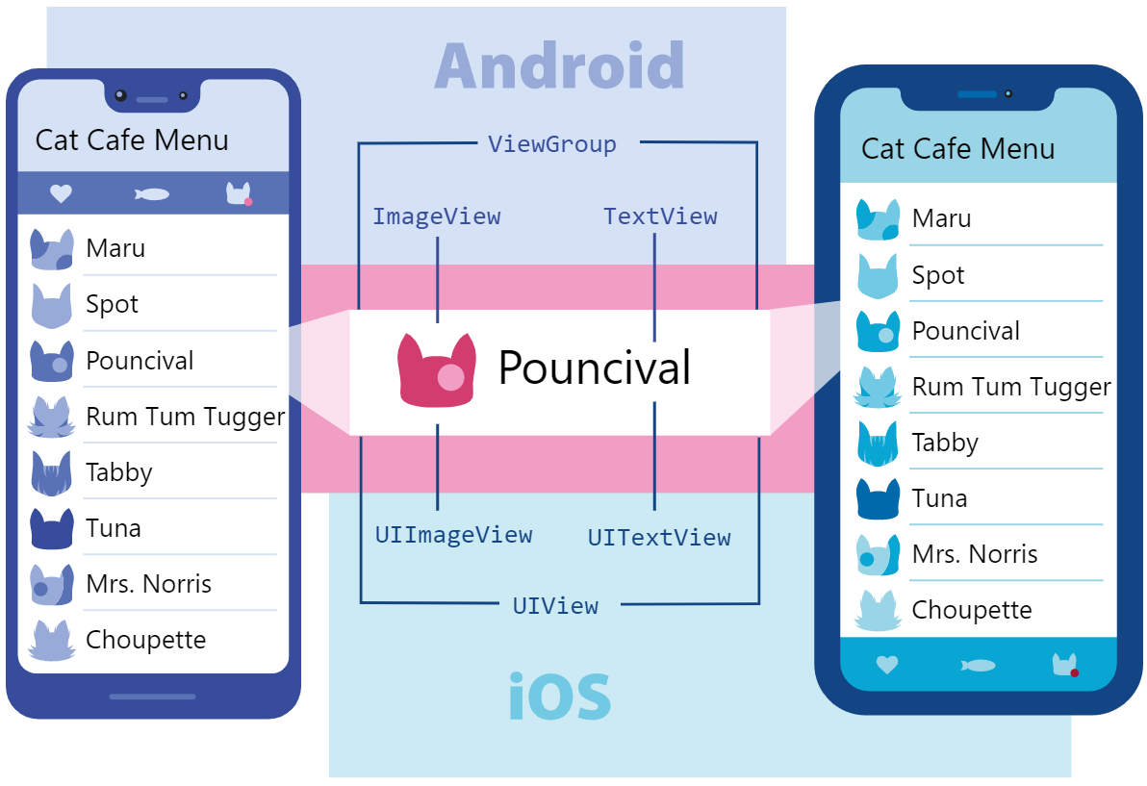
In Android and iOS development, a view is the basic building block of UI: a small rectangular element on the screen which can be used to display text, images, or respond to user input.
In Android you write views in Kotlin or Java; in iOS development, you use Swift or Objective-C.
With React Native, you can invoke these views with JavaScript using React components. Because React Native components are backed by the same views as Android and iOS.

Slide 10
Core Components

Slide 11
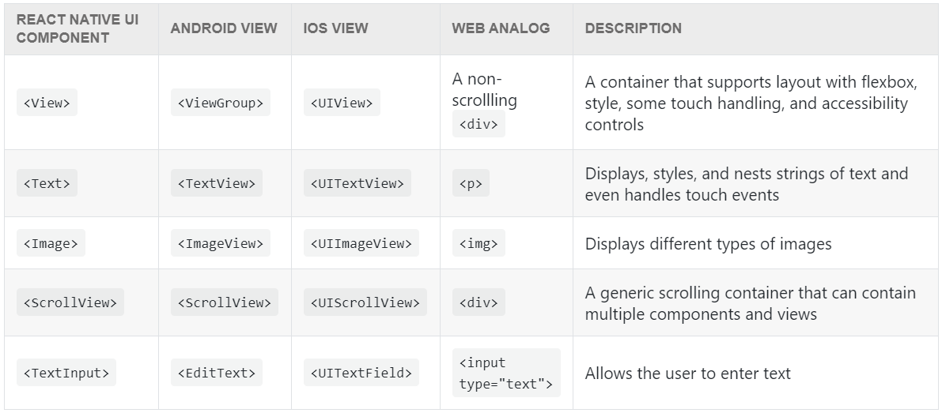
React Native Core Components for everything from form controls to activity indicators. You will mostly work with the following Core Components, see below:

Slide 12
React Fundamentals

Slide 13
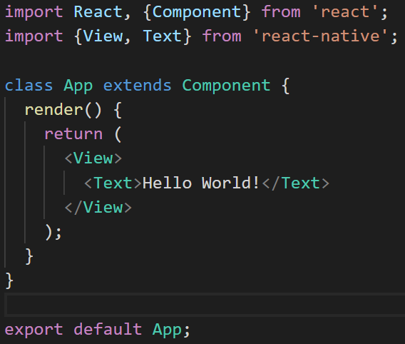
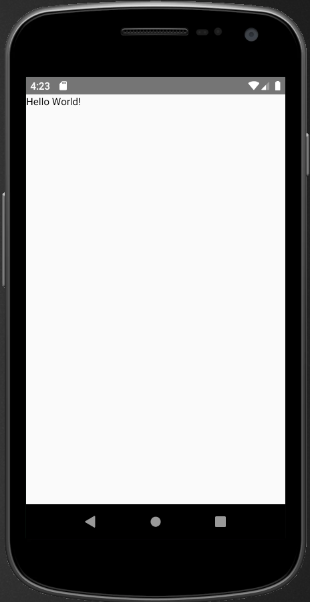
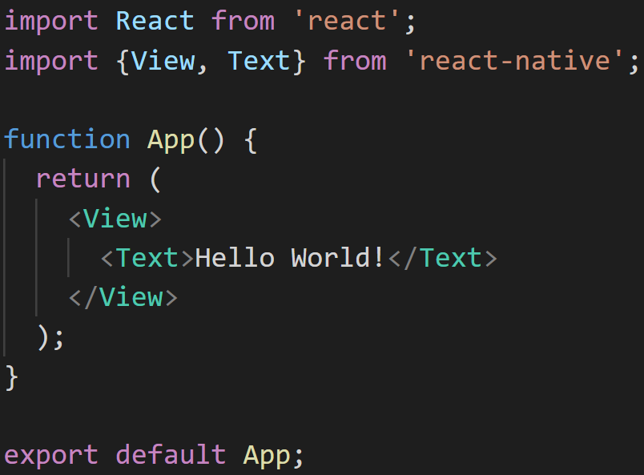
Components
Output:
Class Component:
Function Component:

Slide 14
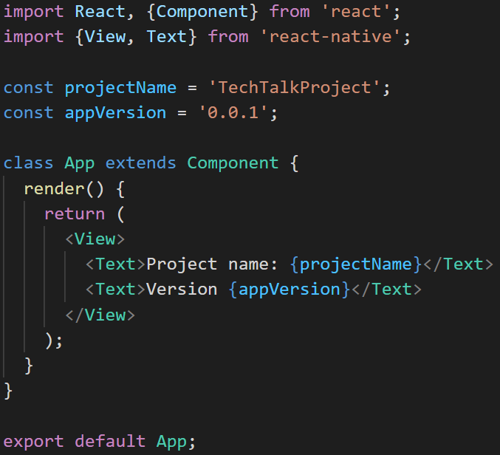
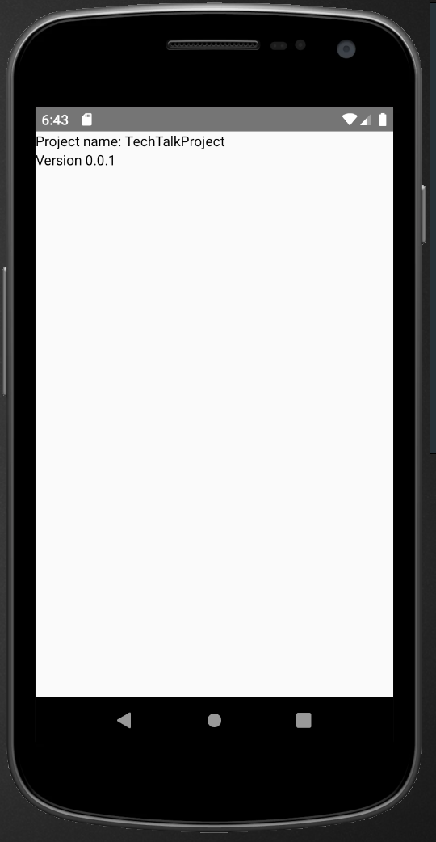
JSX (JavaScript XML)
React and React Native use JSX, a syntax that lets you write elements inside JavaScript.
Sample:
Output:

Slide 15
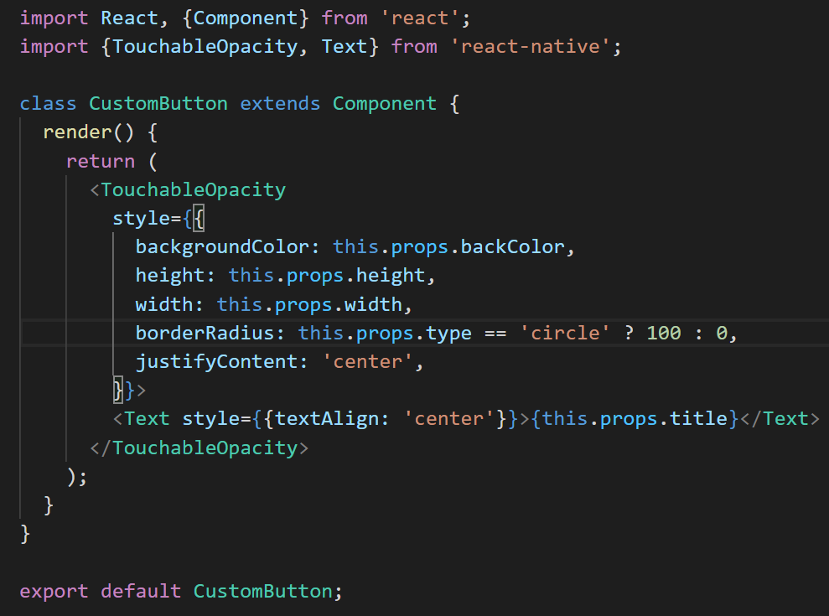
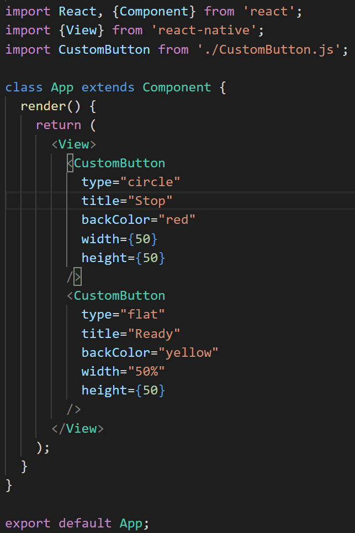
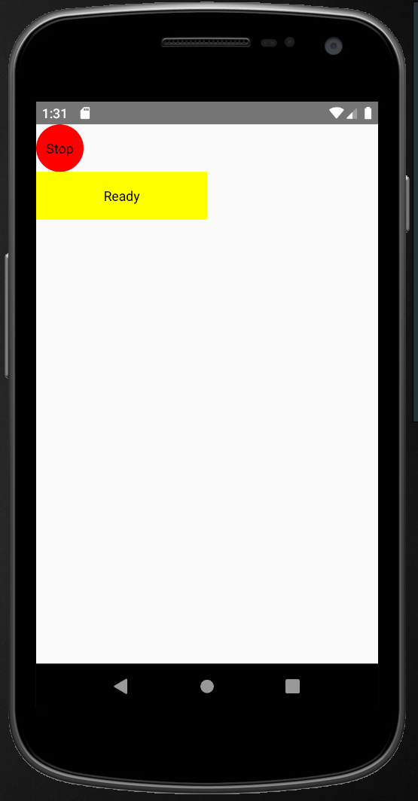
Props
Props is short for “properties.” Props let you customize React components
Sample:
Custom Button Class Component:
App.js:
Output:

Slide 16
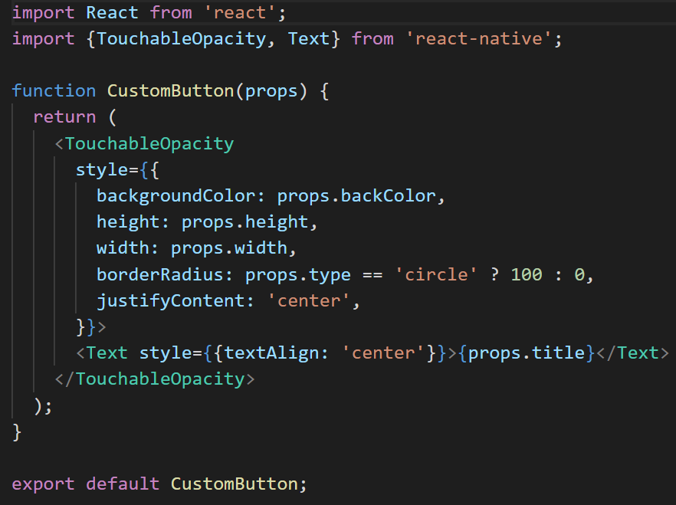
Props
Another sample:
Custom Button Function Component:
App.js:
Output:

Slide 17
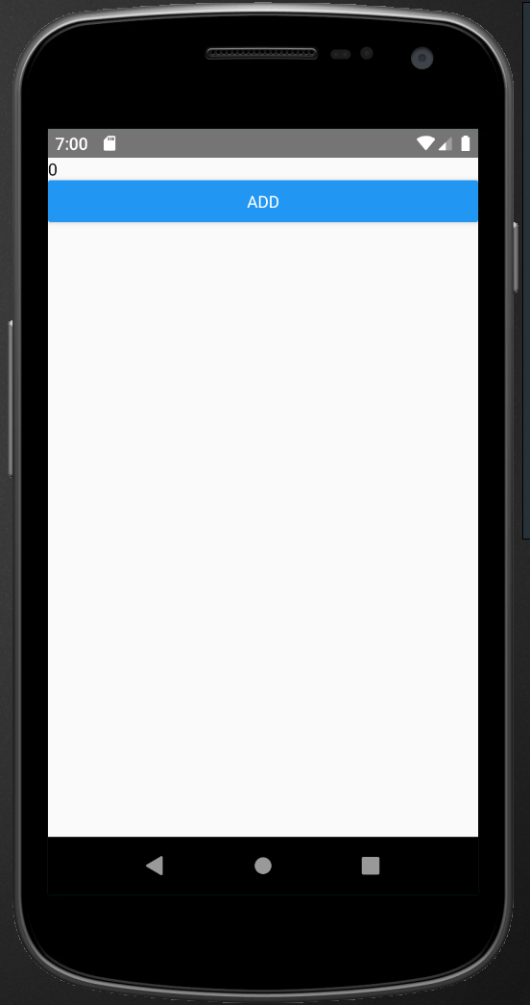
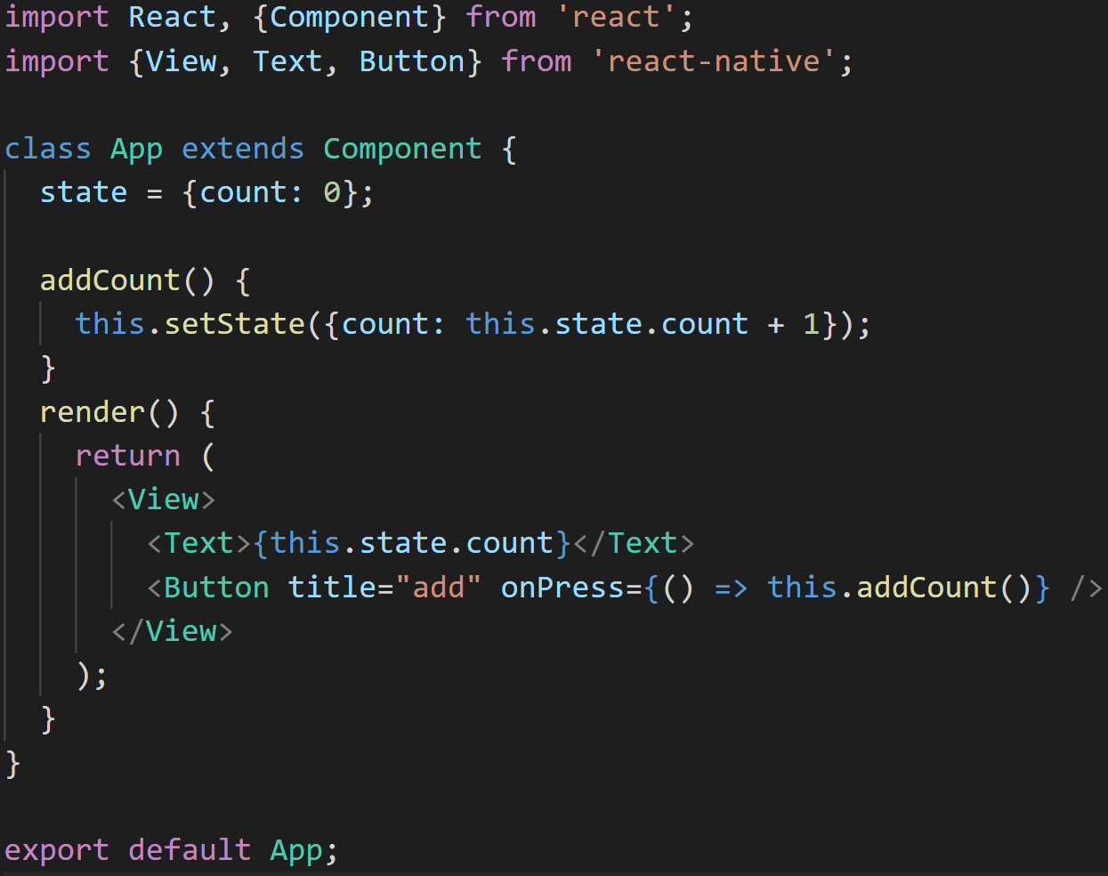
State
State is like a component’s personal data storage. State is useful for handling data that changes over time or that comes from user interaction. State gives your components memory.
Sample in Class Component:

Slide 18
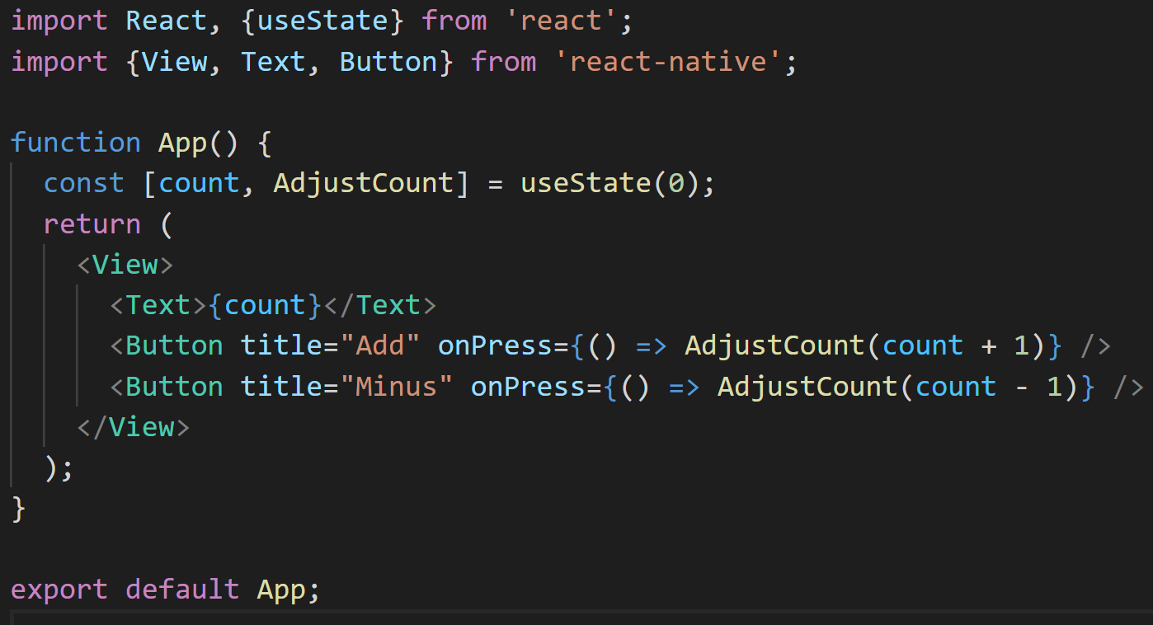
State
Sample in Function Component:

Slide 19
Environment Setup

Slide 20


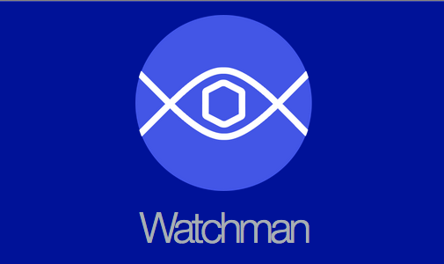
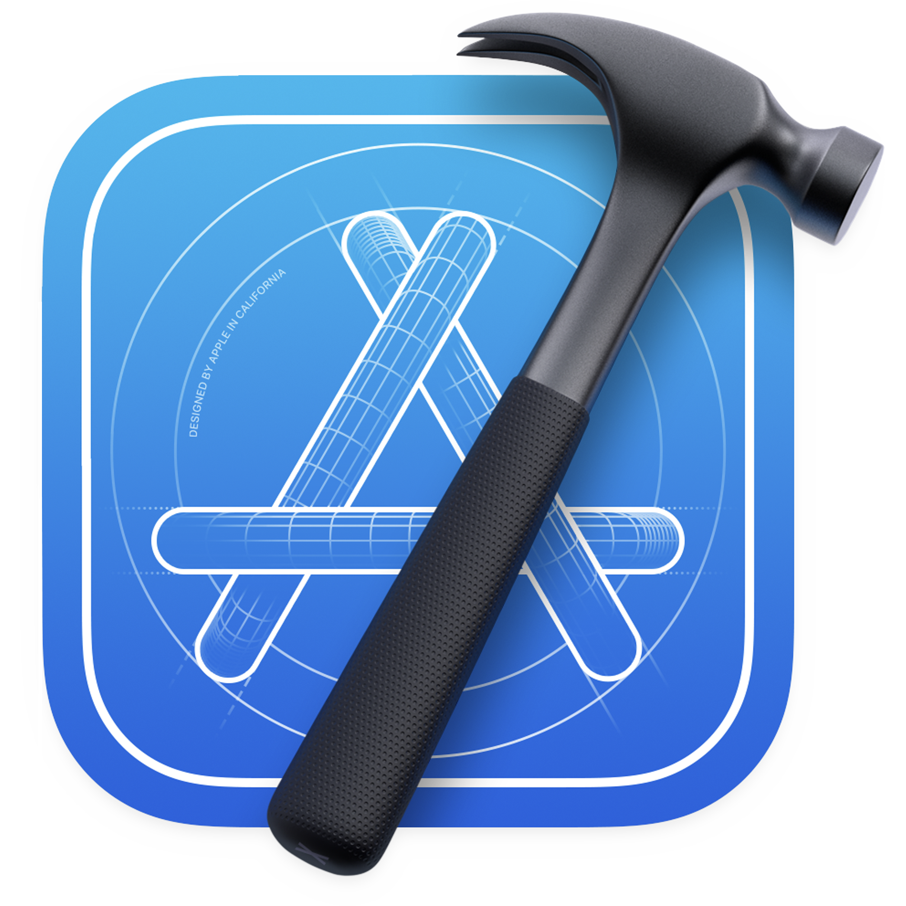
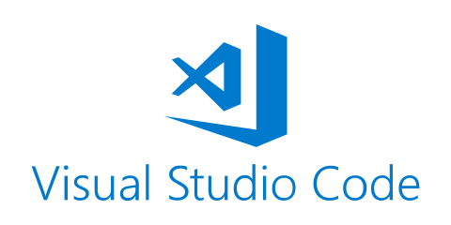

Install Node.js, a JavaScript runtime, to build your JavaScript code.
Installing dependencies
You can use any editor of your choice to develop your app:

Slide 21
Android Emulator Setup

Slide 22
Android Emulator Setup
Install the Android Studio
Note that while on installation wizard, make sure the boxes next to all of the following items are checked:
Android SDK
Android SDK Platform
Android Virtual Device
If you are not already using Hyper-V: Performance (Intel ® HAXM)
2. Install the Android software development kit (SDK)
Android Studio installs the latest Android SDK by default. Specific Android SDKs can be installed through the SDK Manager.
Makesure the following items are checked when installing SDK:
Android SDK Platform <api level>
Intel x86 Atom_64 System Image or Google APIs Intel x86 Atom System Image

Slide 23
Create emulator demo

Slide 24
Demo

Slide 25
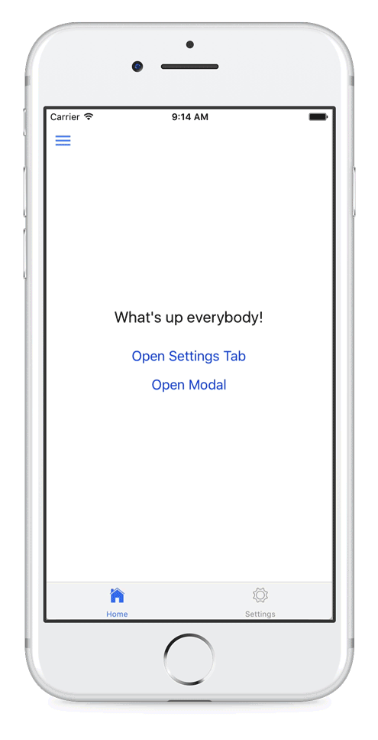
That’s all for the basics!
Next possible tech-talk, I’m going discuss about react-native-navigation package.

